Slide 1
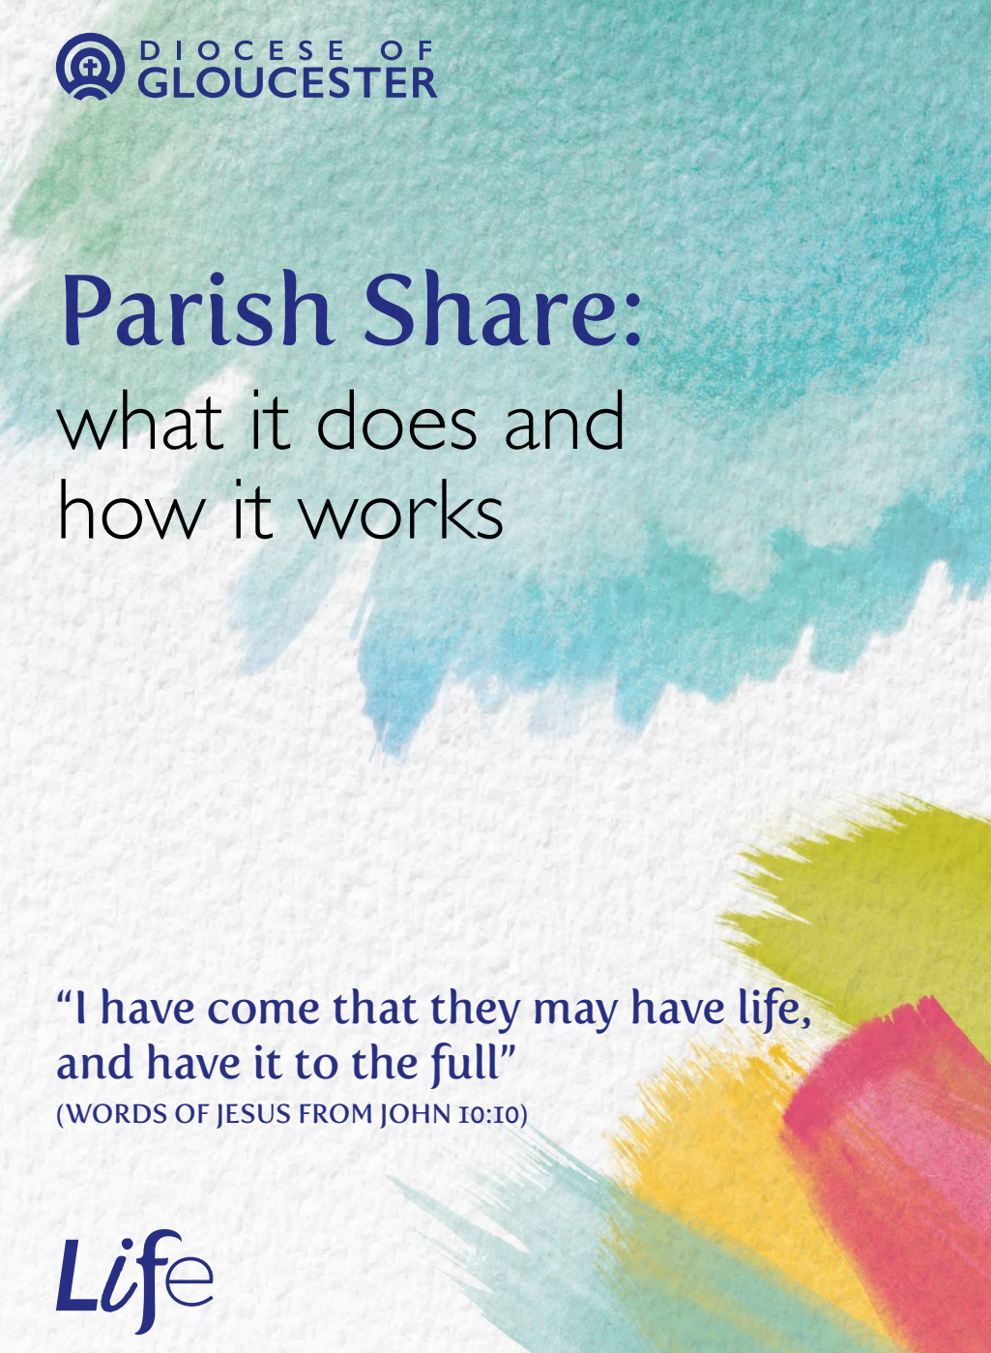

Slide 2
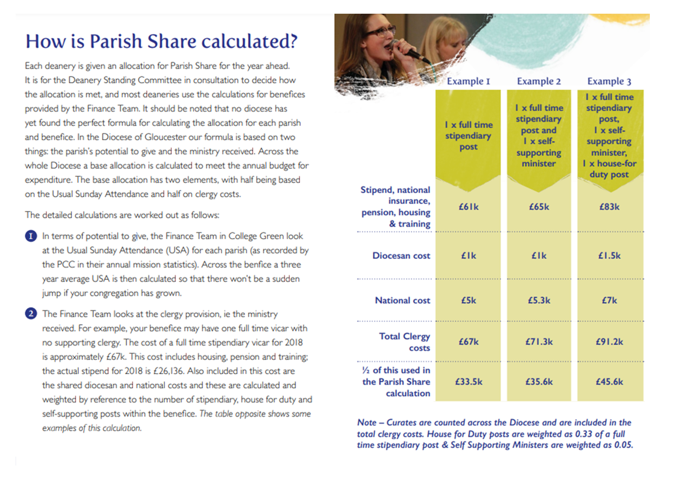

Slide 3


It should be noted that no diocese has
yet found the perfect formula for calculating the allocation for each parish
and benefice. In the Diocese of Gloucester our formula is based on two
things: the parish’s potential to give and the ministry received.

Slide 4


1) In terms of potential to give, the Finance Team in College Green look at the Usual Sunday Attendance (USA) for each parish…. Across the benefice a three year average USA is then calculated so that there won’t be a sudden jump if your congregation has grown.
2) The Finance Team looks at the clergy provision, ie the ministry received. For example, your benefice may have one full time vicar with no supporting clergy. The cost of a full time stipendiary vicar for 2018 is approximately £67k…. [2024 £81k]

Slide 6


2 Questions in 2 Minutes
What’s the greatest misunderstanding about Parish Share that you often come across?
How can we, as members of Diocesan Synod, help improve communication and remove blockages to generous and joyful sharing in the ministry of giving?

