Slide 1
Stroud Deanery Strategic Plan

Slide 2
The Deanery Strategic Plan looks five years ahead, to focus on what we need to become through creative mission and sustainable deployment.
Working together, we aim to reshape the mission and ministry of this Deanery to be more focussed on our shared mission priorities, whilst at the same time reducing our dependence on stipendiary ordained ministry to a level that is sustainable for the long term.
Diocesan staff will work with deaneries to support the deanery planning process and will help to make the plans happen.

Slide 3
The timetable is to have an initial plan by December 2021, which will change over time, but which will be the initial framework for mission partnership and stipendiary clergy deployment
So far in Stroud Deanery we have
Mapped the current life of the Deanery
Thought about what our mission could and should be
Begun to considered whether boundaries, buildings, staff and lay leadership are in the right places
This is an important opportunity for us all to get involved in the discernment process to produce a scheme that meets the future needs of our people and communities

Slide 4
The Context: National Vision – Christ centred, Jesus shaped
“If anyone is in Christ there is a new creation”
(2 Cor 5:17)
A church of missionary disciples
A church that is younger and more diverse
A church where mixed economy is the norm
Simpler, humbler, bolder

Slide 5
The Context: Diocesan Vision – Life in all its fullness
“I have come that they might have life and have it to the full” (John 10:10)
Leadership – committed to transformation
Imagination – opening new paths to faith
Faith – living as adventurous followers of Jesus Christ
Engagement – living out Christ’s love and hope

Slide 6
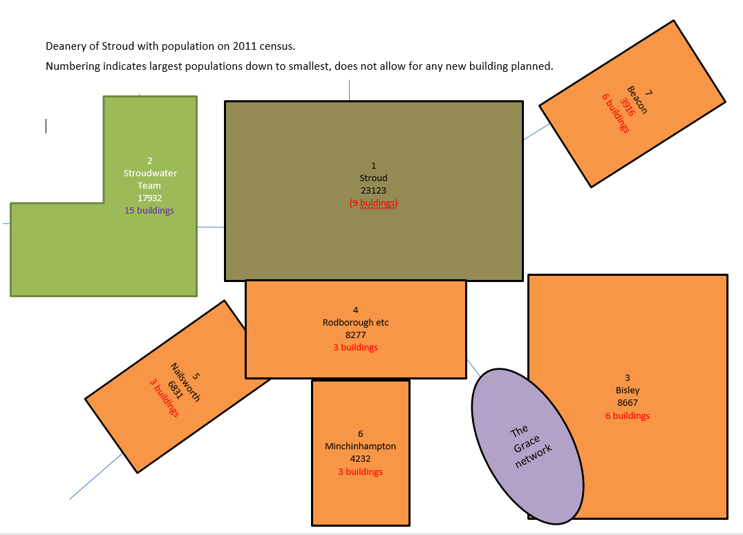

Slide 7
Stroud Deanery Strategic Plan
So far we have been thinking about three areas of mission:
Working with and in existing large areas of housing
Working with and in planned developments across the centre of the Deanery from Stonehouse through Stroud and its environs to areas bordering the A419
Supporting sustainable patterns of ministry in the smaller towns and villages

Slide 8
First discussion questions
15 minutes
What area of ministry do you think is most important in your context? Imagine resources are no object!
What two things would you like to keep doing and what would you stop doing as church when things go back to “normal”?
What would you love your church community to be doing that it isn’t already?

Slide 9
Second discussion questions
15 minutes
How do we reach out to younger generations – not just
children but younger generations of adults?
(National vision)
2. How can we flourish together? What do we share in
common across the benefice and Deanery?
3. What could we do better together in our benefices, as a
Deanery and in the wider community?

