Slide 1
Diocese of Gloucester Carbon net zero 2030 Being advocates for flourishing through initiatives which combat injustice, environmental destruction, exclusion and isolation.

Slide 2
Theological introduction

Slide 3
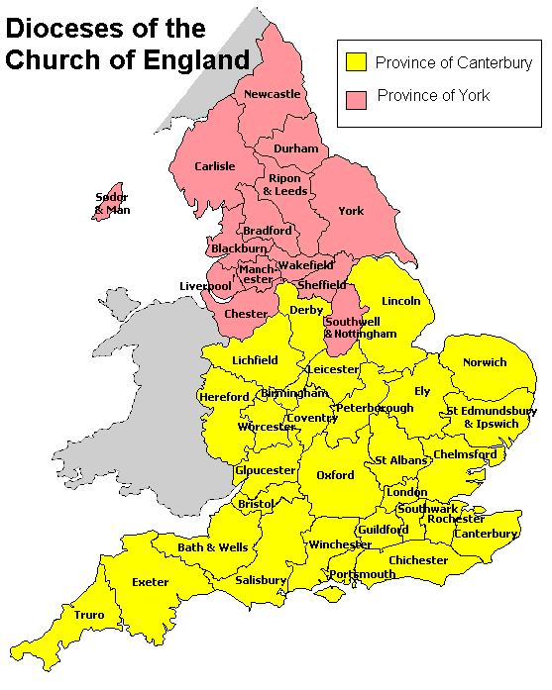
New net zero appointment
Gloucester, Hereford, and Worcester Dioceses

Slide 4
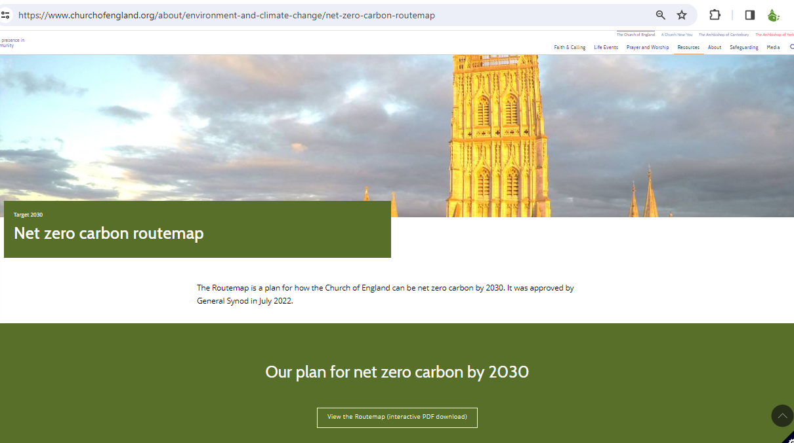
Routemap to net zero: baseline principles
‘It is possible to reduce carbon emissions from nearly every building by relatively easy and cheap methods that reduce energy consumption, improve energy efficiency and make the building more comfortable.
Eliminating all carbon emissions from a building is more challenging and costly, although it can be done with existing technologies.
The Routemap therefore prioritises identifying high energy-consuming, high carbon-emitting buildings, and developing plans to tackle carbon emissions from them.’

Slide 5
Baseline and consultancy

Slide 6
Milestones and priorities
From report to synod: see report to read the details.

Slide 7
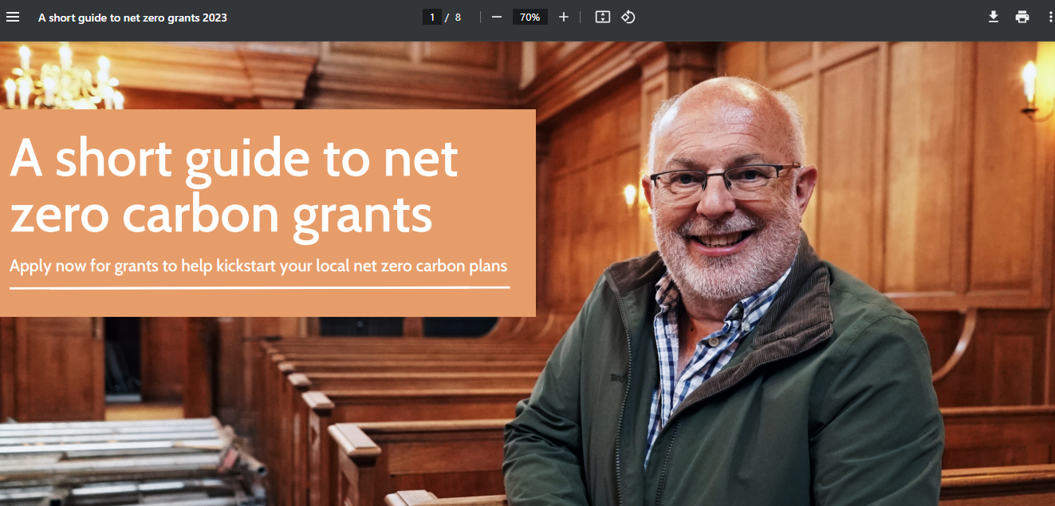
Funding

Slide 8
Image showing awards only – 40% of our churches are signed up.

