Slide 1

PRESENTATION FOR STROUD DEANERY
October 2024

Slide 2
Our Vision
“Inspired by the Gospel of Jesus Christ, we seek to be in Tune with Heaven and in Touch with Daily Life.”
Our Purpose
Our mission is to enable transformational change by providing a place which offers hope and hospitality in the love of our Lord Jesus Christ to all whom we encounter. Whoever you might be, wherever you are on your personal journey, you are welcome here in the name of Christ.

Slide 3
Four Strategic Priorities
Deepening Spirituality
Extending Hospitality
Growing People & Communities
Revitalising Heritage

Slide 4
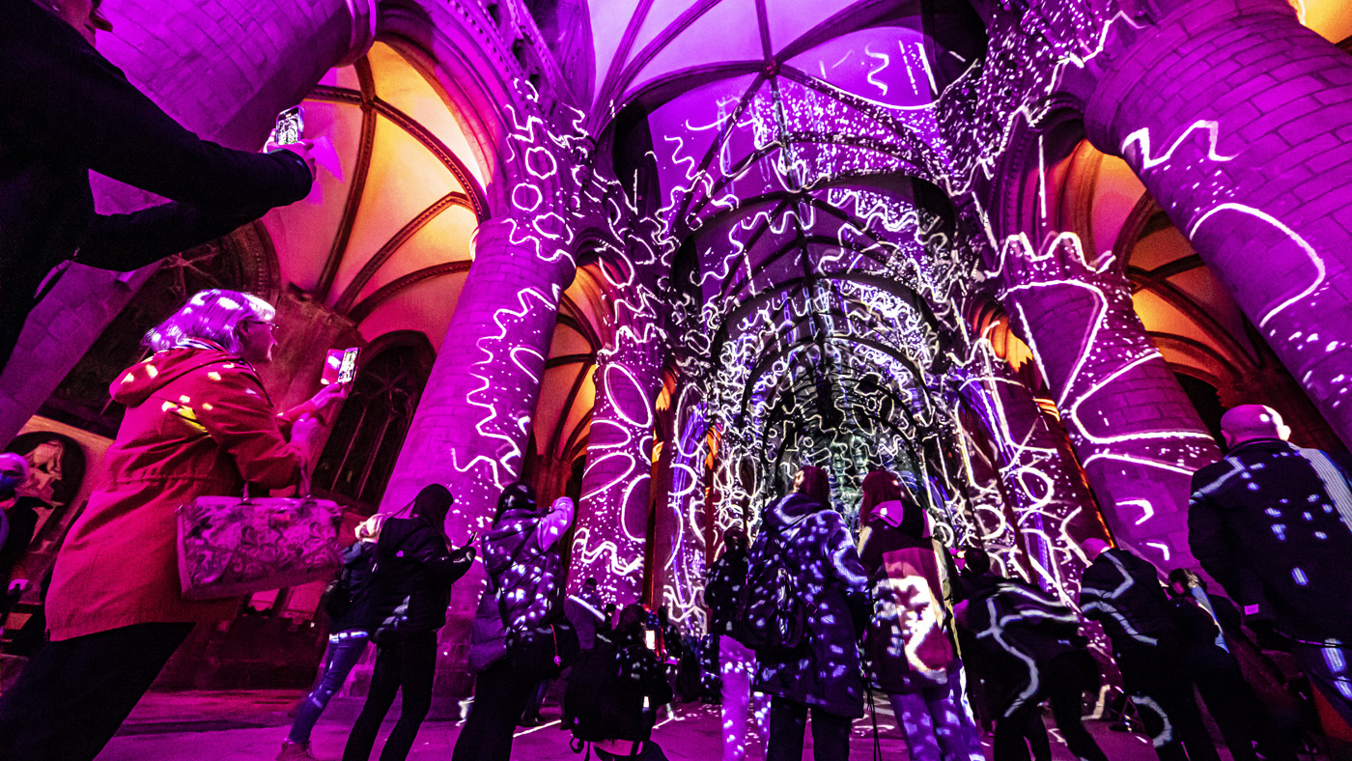
Extending Hospitality

Slide 5
1. Extending Hospitality
Purpose
To offer a heartwarming welcome and outstanding experience, following the Gospel principles of hospitality, which makes people feel they belong, whatever the purpose of their visit.
Aims
  Welcome more visitors to come to experience something of the love of Christ, exemplified through all that the Cathedral offers.
  Attract underrepresented communities through effective programming and partnerships.
  Improve the quality of visitor experience, following our Benedictine tradition of hospitality.
Key Areas for Diocese/Deaneries
Always welcome at YOUR Cathedral | Place of refreshment | Sense of belonging at the Cathedral

Slide 6
Deepening Spirituality

Slide 7
2. Deepening Spirituality
Purpose
To provide accessible and enriching spiritual engagement, appropriate pastoral care and the highest standards of liturgy.
Possible Goals
  Intentionally increase worship attendance and diversifying congregations.
  Ensure that every visitor can access appropriate pastoral support through teams of Chaplains.
  Provide opportunities for everyone to engage with the Cathedral on a spiritual level, wherever they might be on their faith journey.
Key Areas for Diocese/Deaneries
Diocesan services | Programme of Deanery Evensongs | Choirs visiting parishes | Opportunities for Quiet Days at the Cathedral

Slide 8
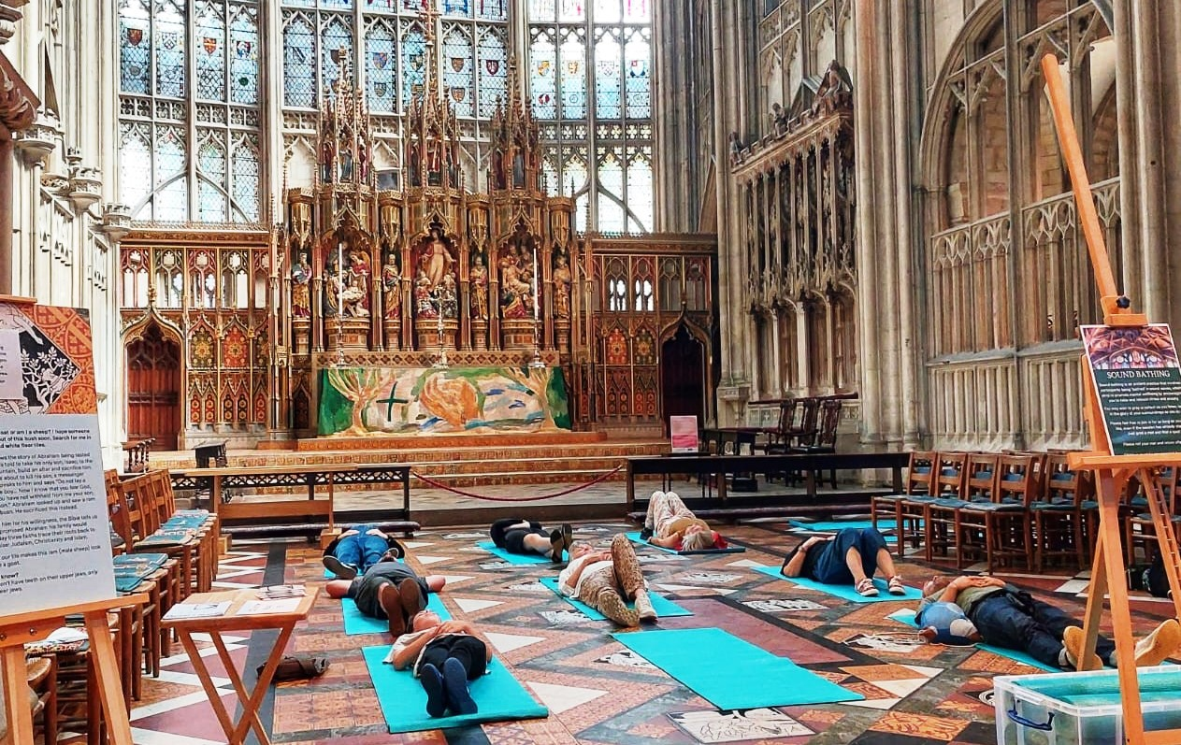
Growing
People & Communities

Slide 9
3. Growing Learning & Participation
Purpose
Using our USPs (place, partnerships and impact) to build community, improve wellbeing, inspire personal development and present our Christian faith in an accessible and attractive way.
Possible Goals
  Nurturing the whole person: educational and wellbeing activities for all ages e.g. school visits, Breakfast Club, family activities, lectures, Summer of Mindfulness
  Offering opportunity: creative, inclusive and relevant roles for audiences to participate in all aspects of Cathedral life and to develop new skills, e.g. volunteering, partnerships with local organisations
  Developing talent: sustainable learning, music and heritage programmes, e.g. stonemason apprentices, music academy
Key Areas for Diocese/Deaneries
Schools Tours and education programmes | In Tune music outreach programme through organ and singing academies | Lectures and exhibitions | Enabling connections between life and faith.

Slide 10
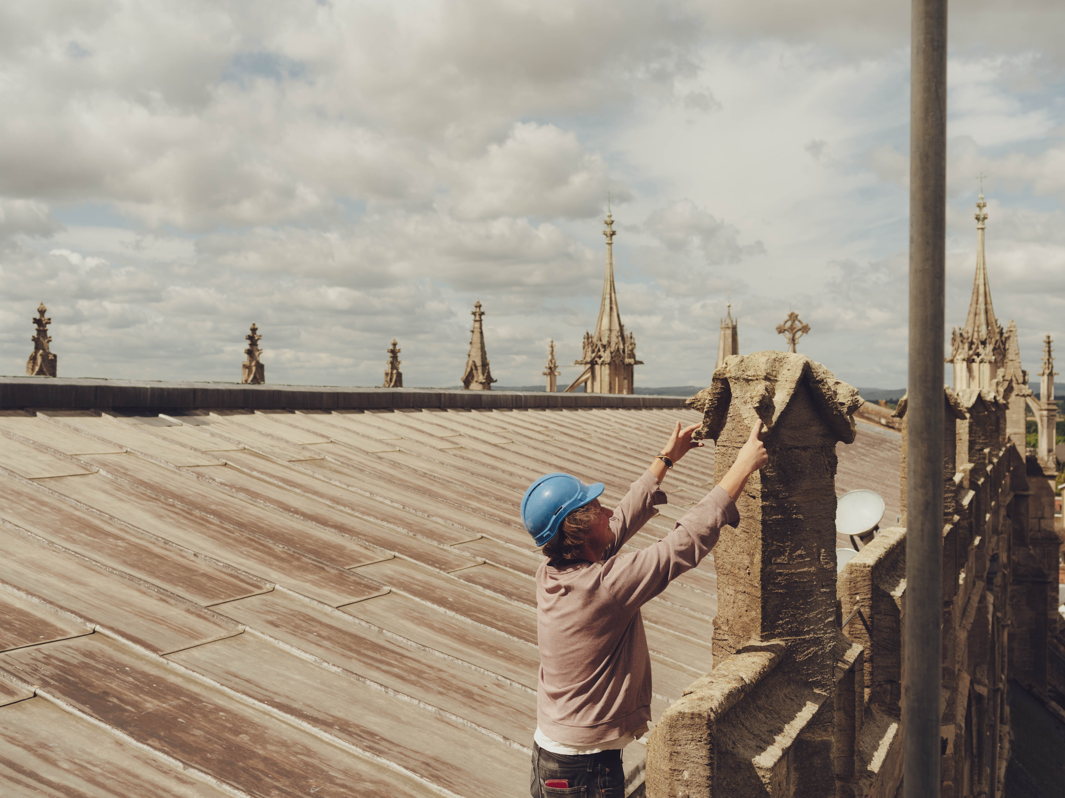
Revitalising Heritage

Slide 11
4. Revitalising Heritage
Purpose
Securing the future of our Cathedral for the next generation, so that the Gospel of Christ’s love for all can continue to be proclaimed.
Possible Goals
  Tangible heritage: conserving, developing and greening the cathedral and its physical assets for the benefit of people and communities, and for our mission, today and always.
  Intangible heritage: sustaining our spiritual and musical traditions by widening participation and increasing relevance and engagement in the Gospel.
  Building investment: establish meaningful connections to unlock long-term financial sustainability and also to further mission and our principle of hospitality.
Key Areas for Diocese/Deaneries
Net Zero Programme | Joined-up working with the Diocese | Explore ways of collaboration

Slide 12
Questions and Comments

